Slide 1
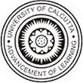
Portuguese built heritage in West Bengal: heritage tourism towards promoting academic and cultural relations between India and Portugal
Mahua Chakraborty
Department of Museology,
University of Calcutta
mchakrabarti20@gmail.com
91-9830237162

Slide 2
Line of discussion
Overview
Analysis
Objectives
Strategies
Implementation

Slide 3
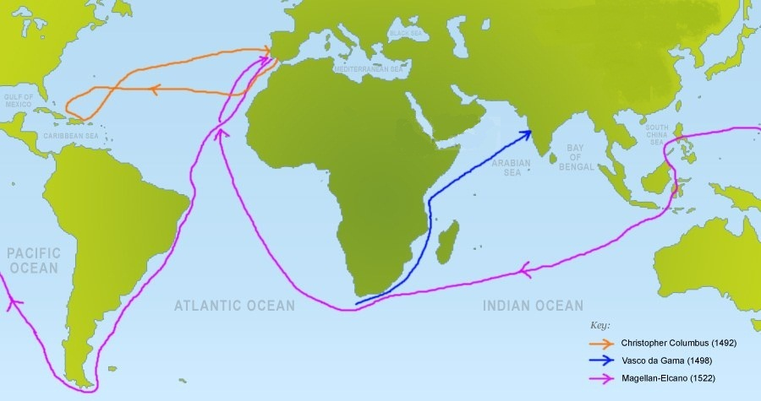
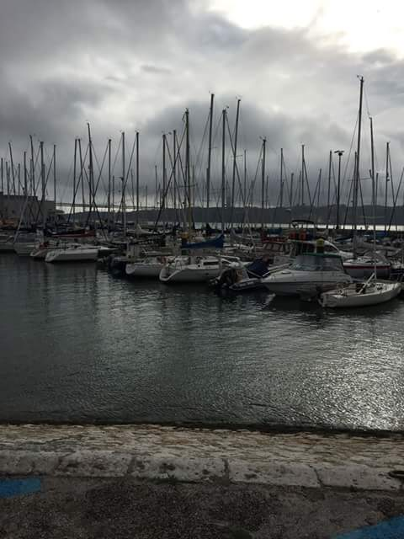
The sea route (Age of Discovery, 15th Century)

Slide 4
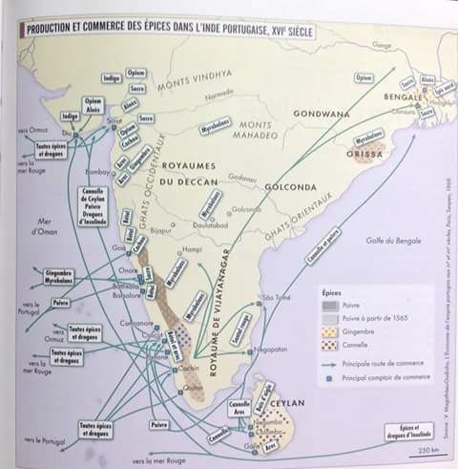
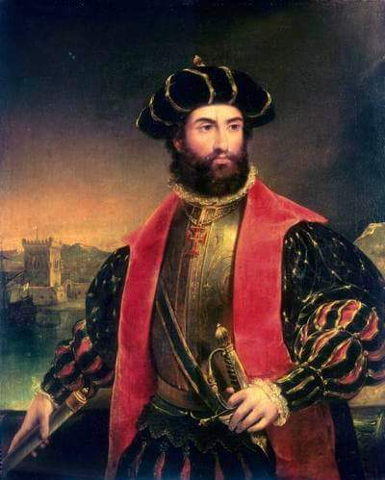
Portuguese settlements in India

Slide 5
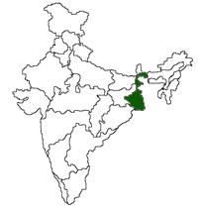
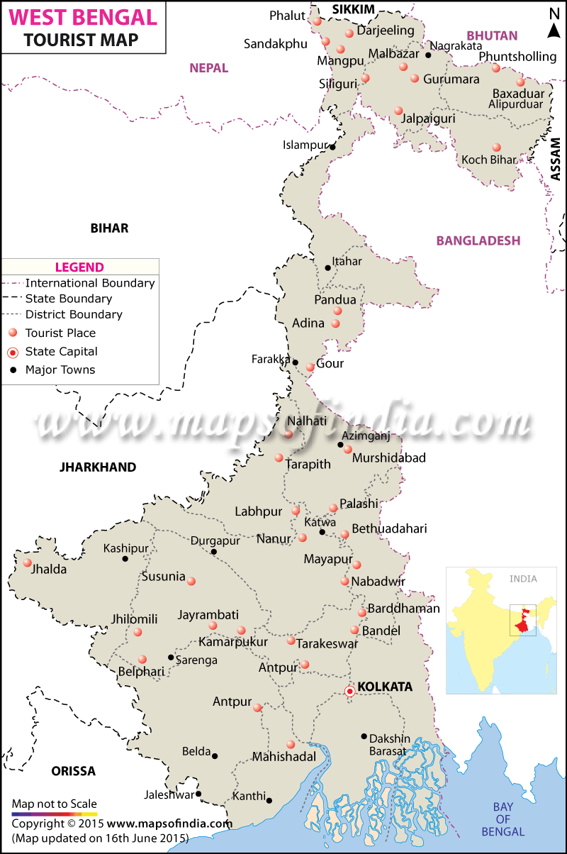
European settlements around the Hooghly river, West Bengal

Slide 6
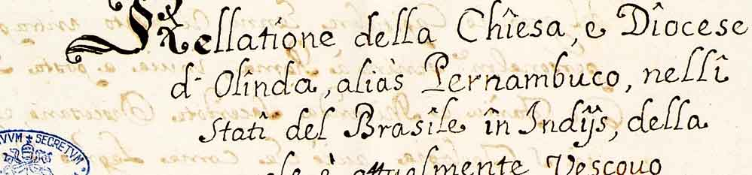
Portuguese built heritage of West Bengal

Slide 7
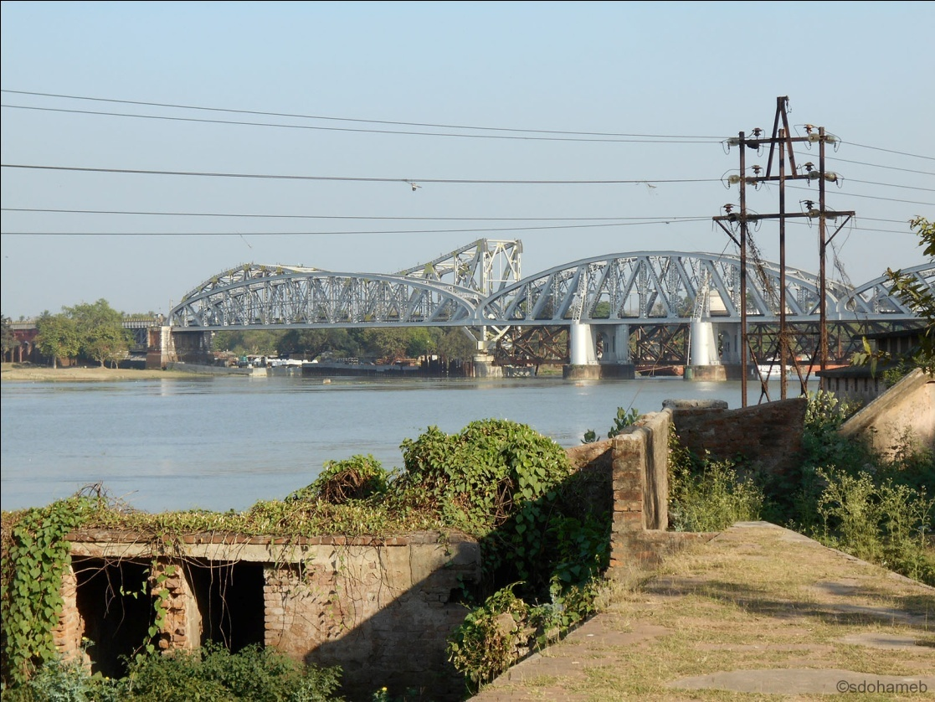
Ruins of the supposed Portuguese fort in Hooghly

Slide 8
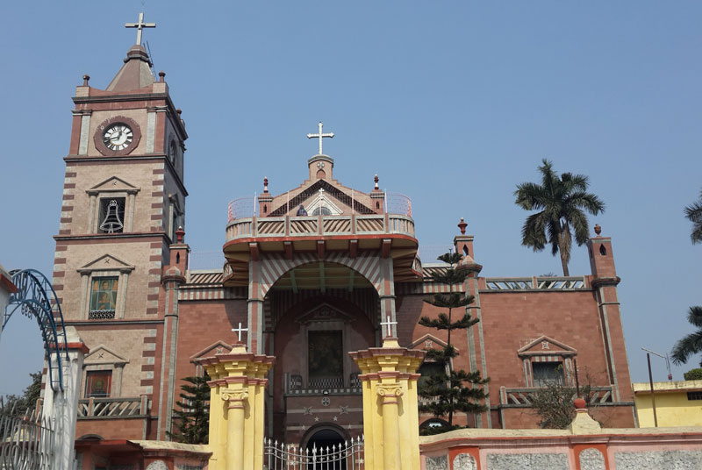
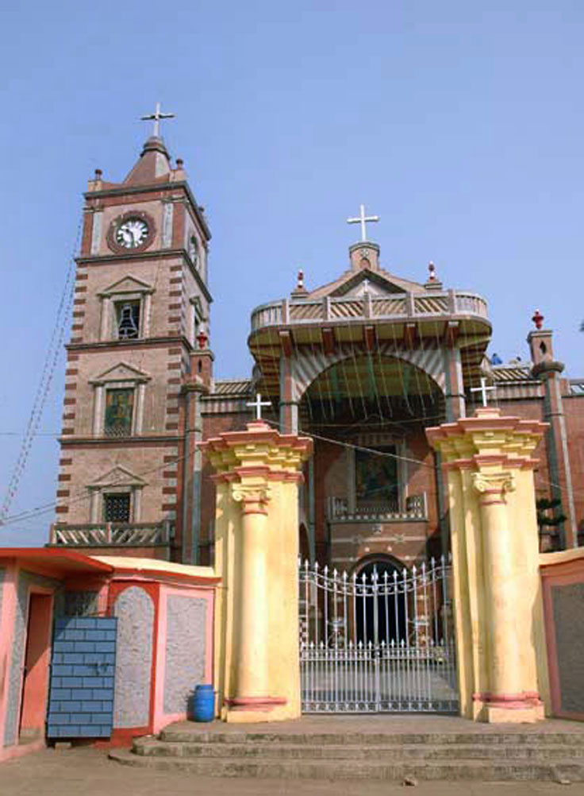
The Basilica of the Holy Rosary, Bandel, 1599

Slide 9
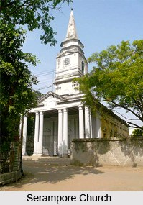
Church of Santa Madre de Deus (Holy Mother of God), Srirampur, Hooghly, 1783

Slide 10
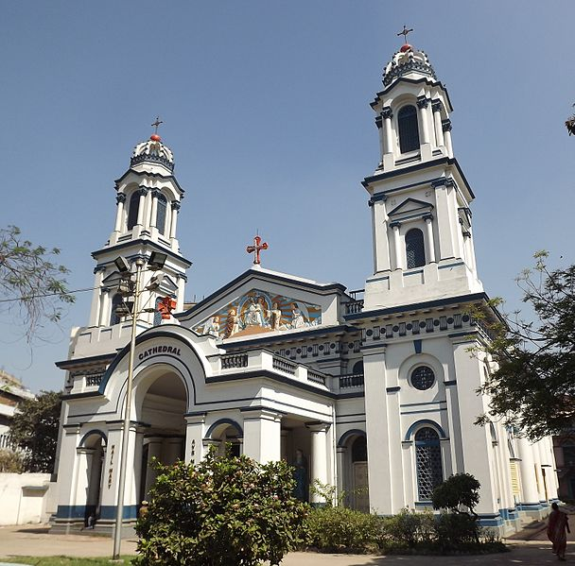
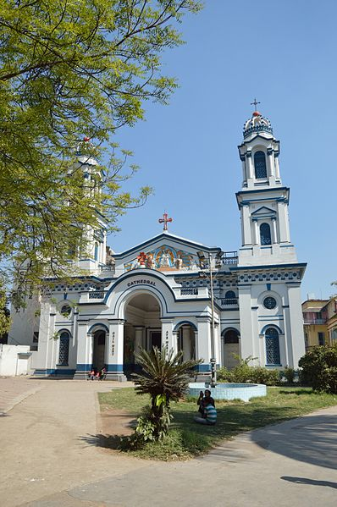
Our Lady of the Rosary, Portuguese Street, Kolkata, 1797

Slide 11
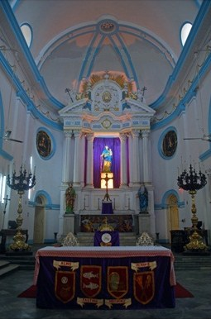
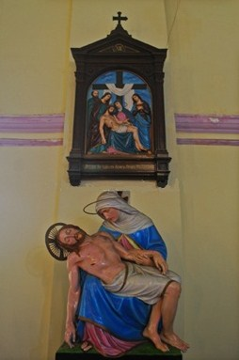
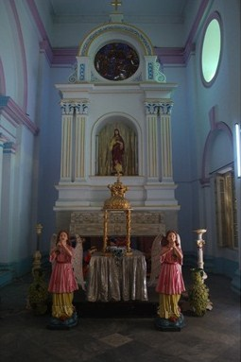
Interior views

Slide 12
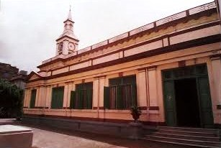
Church of Our Lady of Dolours (Nossa Senhora de Dores), Boitakhana, Kolkata, 1809

Slide 13
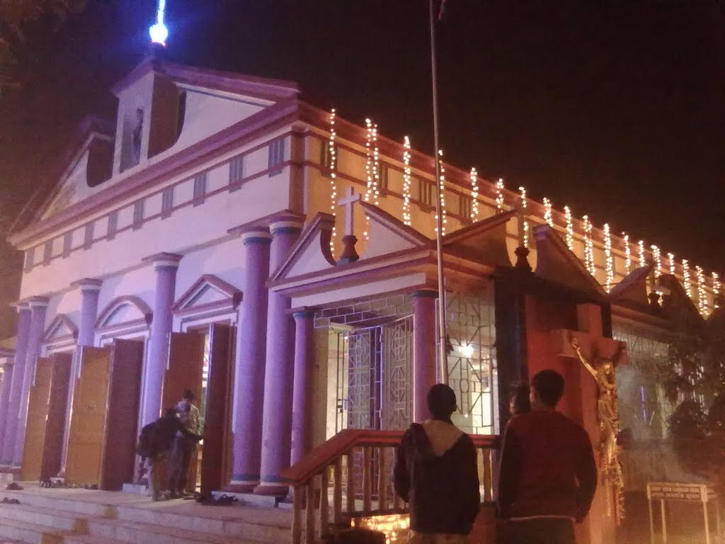
St. Patrick’s Church, Dum Dum, Kolkata, 1822

Slide 14
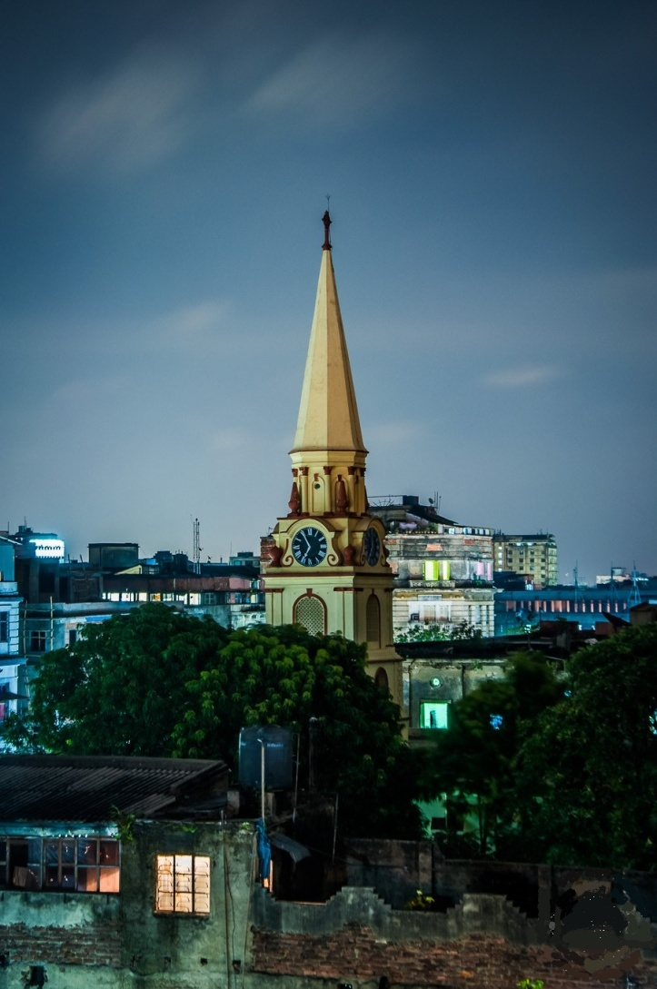
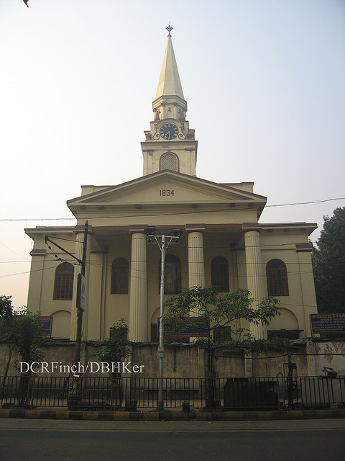
Church of the Sacred Heart of Jesus, Dharamtala Street, Kolkata, 1834

Slide 15
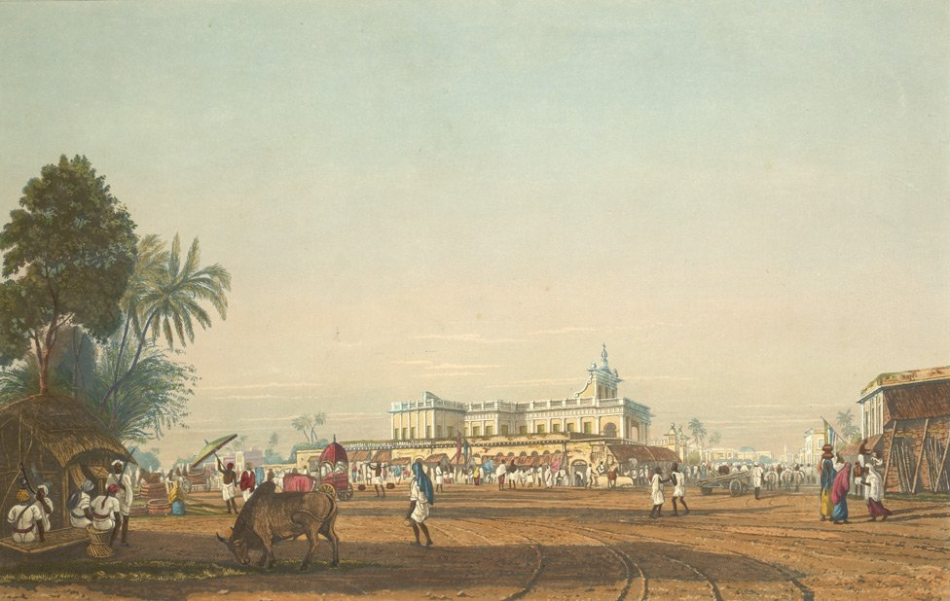
Old view - Church of the Sacred Heart of Jesus, Kolkata

Slide 16
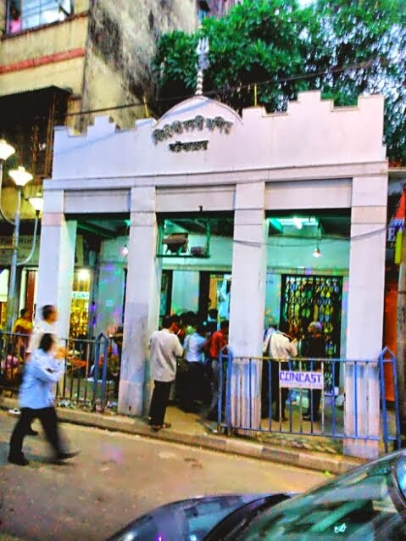
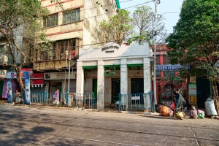
Firingi Kalibari, Kolkata

Slide 17
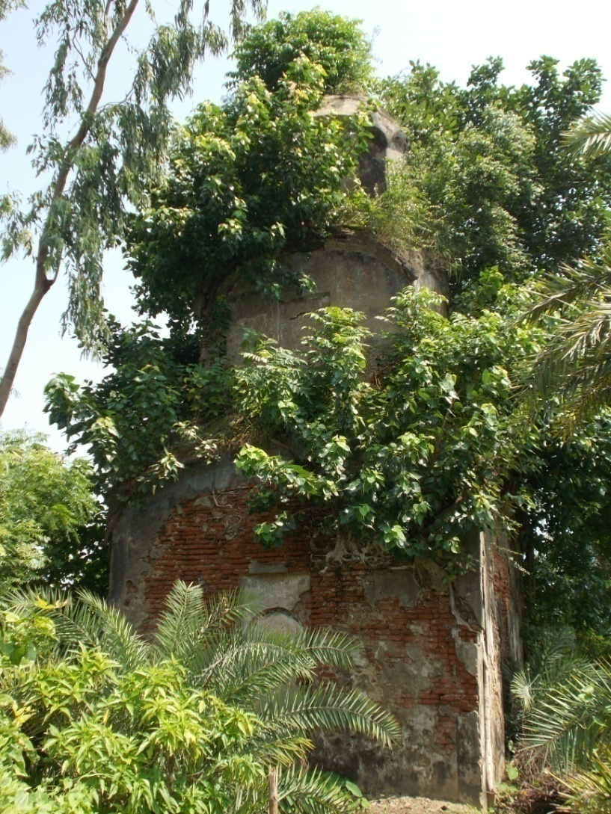
Memorial dedicated to an unknown Portuguese lady, Kulpi, District South 24-Parganas

Slide 18
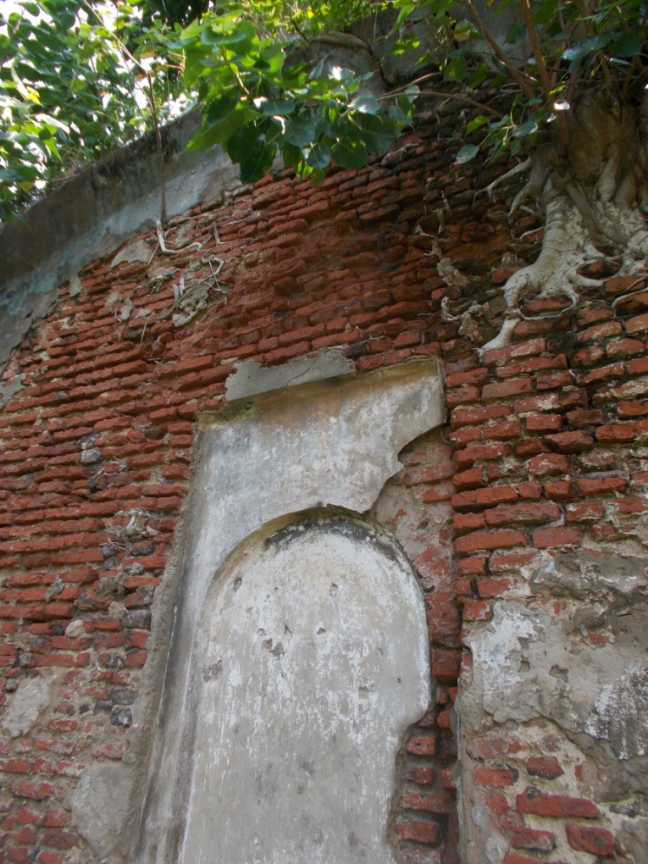
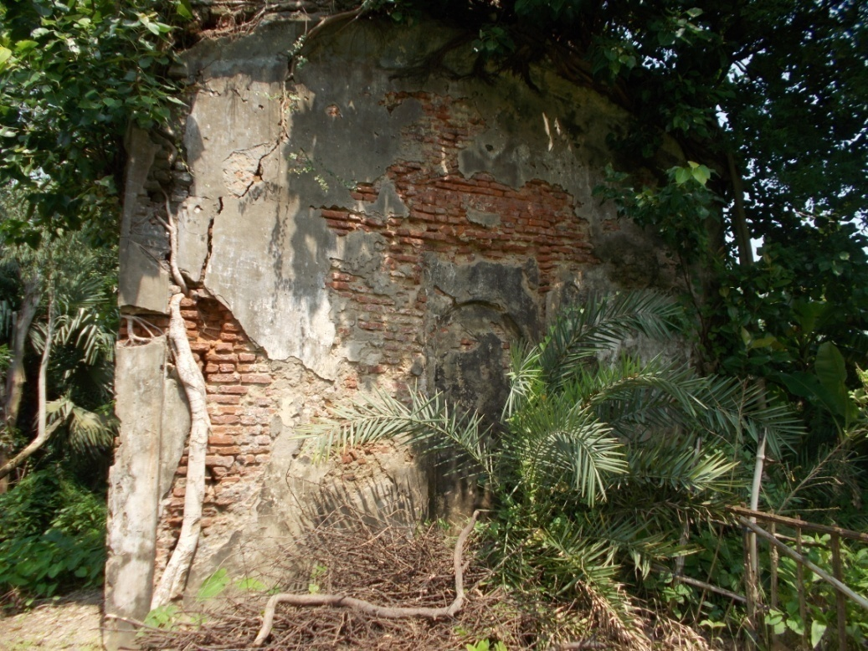
Contd….

Slide 19
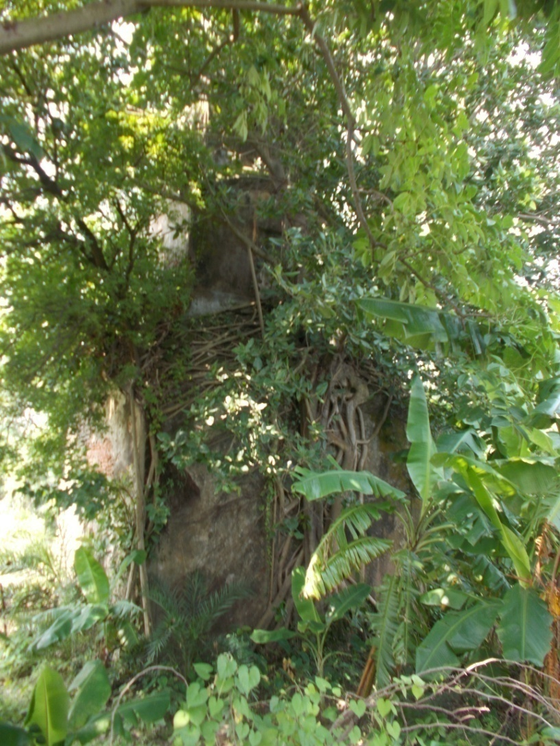
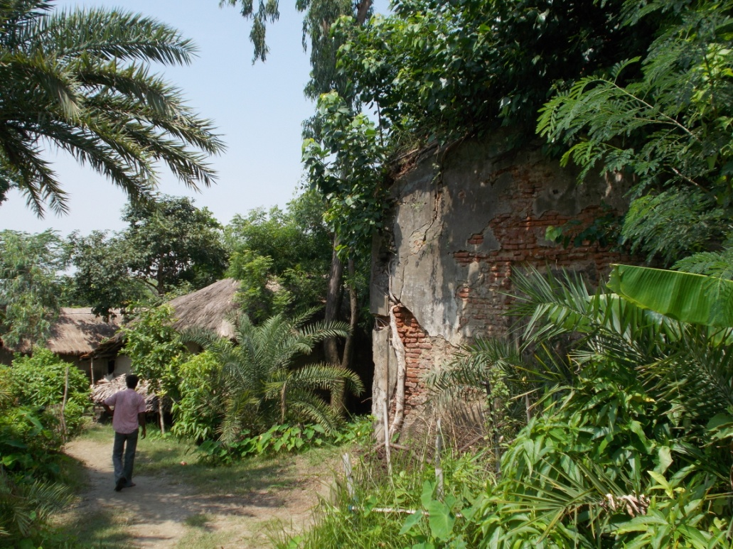
Contd..

Slide 20
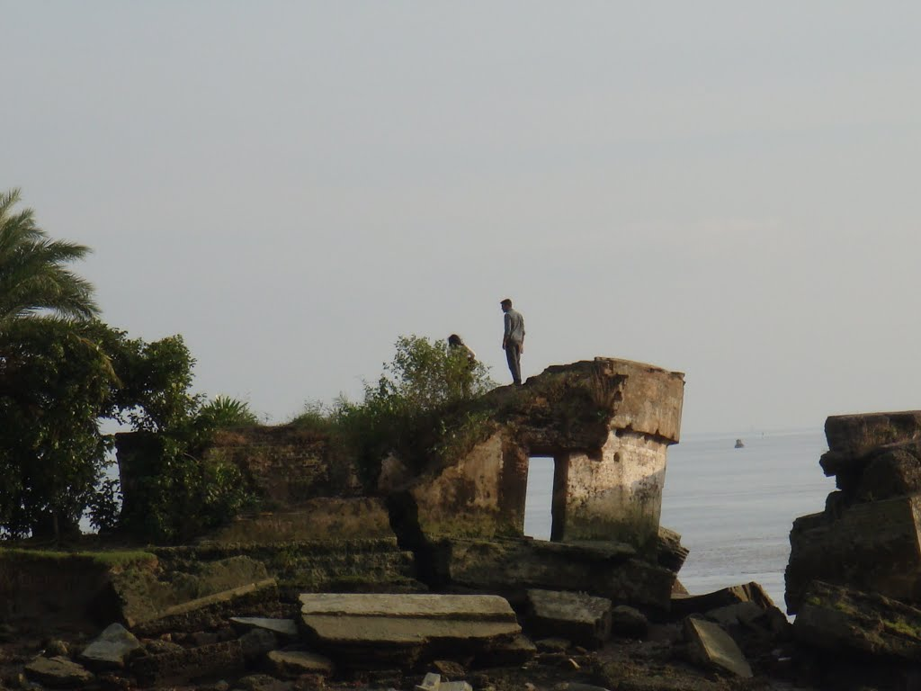
Chingrikhali Fort, Diamond Harbour

Slide 21
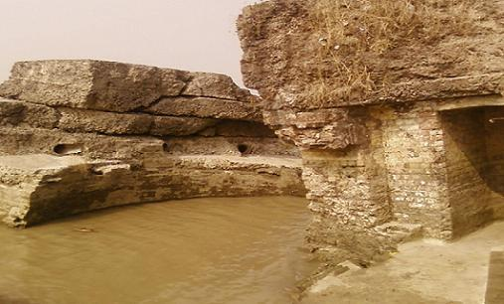
Contd…

Slide 22
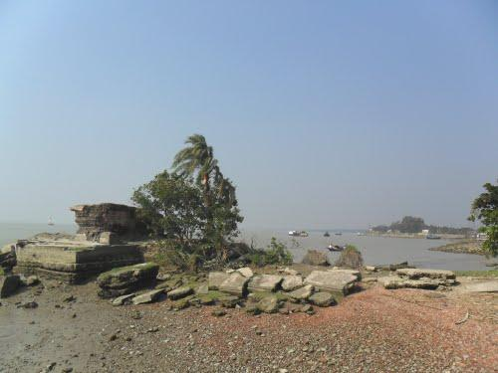
Contd…

Slide 23
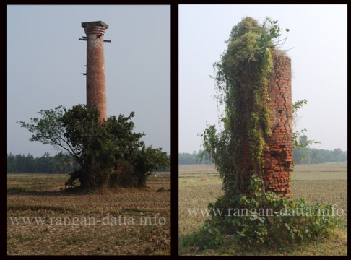
Abandoned Lighthouses, Kulpi, Diamond Harbour (left: Engineberia, right: Kalitala)

Slide 24
Heritage tourism towards promoting academic and cultural relations between India and Portugal

Slide 25
SWOT analysis of Heritage Tourism in West Bengal
Strengths Many historical monuments with scenic beauty Efficient transport facility | Opportunities Increased privatization Medical tourism Go-green initiative World-class hotels and airport
Weakness Lack of adequate infrastructure Safety and security of foreign tourists Misconception about India by foreign tourists Lack of maintenance of monuments Knowledge of English by minority of local people Distance from major city area | Threats Vandalism Better promotion by other states/countries Economic slowdown Inclination of Gen-Y towards social media

Slide 26
Objective
Promoting academic and cultural relations between India and Portugal
Tool
Heritage tourism

Slide 27
Strategies for heritage tourism
SWAGAT – Hospitality Facilitation on arrival Memorable experience SOOCHNA – Information Marketing and promotion Information dissemination SUVIDHA – Facilitation Accommodation and stay Amenities and conveniences SURAKSHA – Security / protection Tourist safety Environment management SAHYYOG – Cooperation Coordination Quality control and assurance SANRACHNA – Infrastructure Tourism product development Core and linkage infrastructure | POLICY PLANNING INITIATIVES RESULTS

Slide 28
Implementation
1. Who? i.e. Collaborators (Department of Museology, University of Calcutta & ISCAP, Porto )
2. What? i.e. academic and cultural relations between India and Portugal
Where? (in India or Portugal)
Why?
How?

Slide 29
Why collaboration needed?
To identify trends and specific areas of mutual interest – Primarily academic and secondly economic
To stop decay and preserve the heritage resources for posterity
Accurate interpretation of resources
Authentic visitor experiences
Support the economy

Slide 30
Collaboration will be in forms of –
Exploratory visits to Portuguese built heritage sites in West Bengal.
Promote exchange and dissemination of information and scientific opportunities through joint workshops, seminars and symposia, etc.
Exchange of museologists, researchers and technocrats through fellowship
Extending avenues for training in specialized areas of R & D
Establishing joint ‘Centers of Excellence’ in advanced areas of R&D in India or Portugal and networking among those.

Slide 31
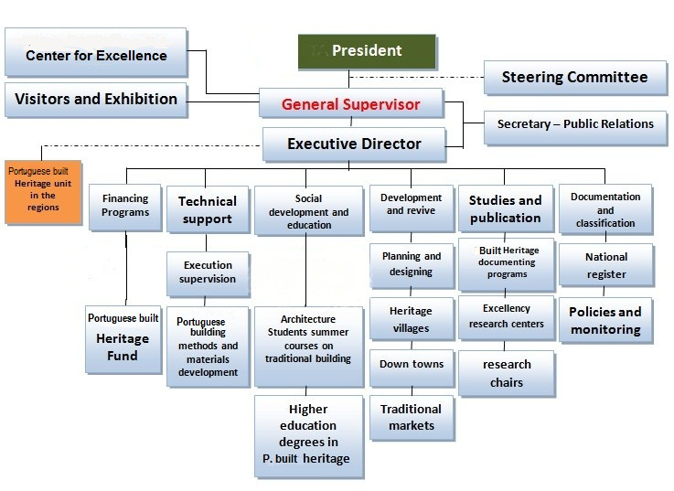
Organization of collaboration programme (proposed)

Slide 32


